Slide 1
CMPSC 497C Lab 10 Website Hacking
Zhifeng Xiao

Slide 2
Agenda
Understanding the basics of HTTP
Configuration of Webgoat and Burpsuite
Drills

Slide 3
HTTP vs HTML
HTML: hypertext markup language
Definitions of tags that are added to Web documents to control their appearance
HTTP: hypertext transfer protocol
The rules governing the conversation between a Web client and a Web server
Both were invented at the same time by the same person

Slide 4
HTTP Basics
HTTP layered over bidirectional byte stream
Almost always TCP
Interaction
Client sends request to server, followed by response from server to client
Requests/responses are encoded in text
Stateless
Server maintains no information about past client requests

Slide 5
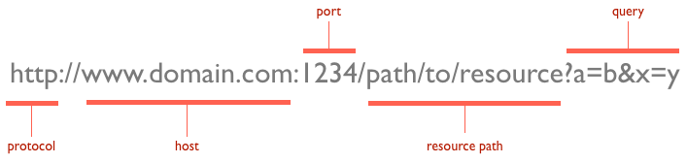
URL components
Example
ftp://www.ftp.org/docs/test.txt
news:soc.culture.Singapore
telnet://www.test101.com/

Slide 6
Http Basics
What happens when you input your URL, and hit enter?

Slide 7
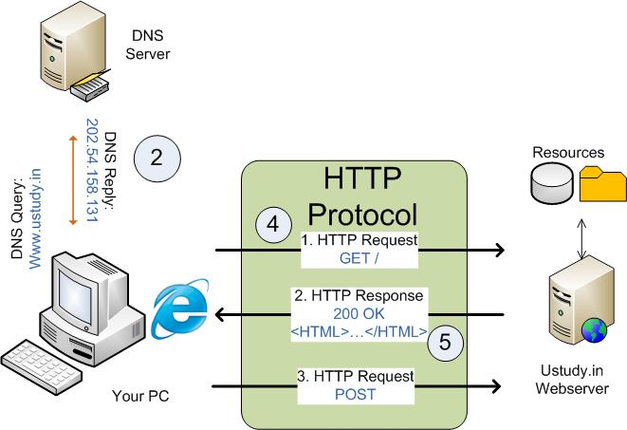
Http basics

Slide 8
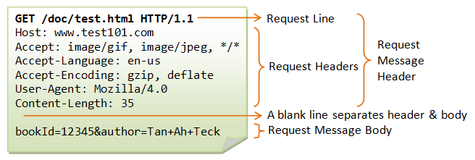
Http Header - request

Slide 9
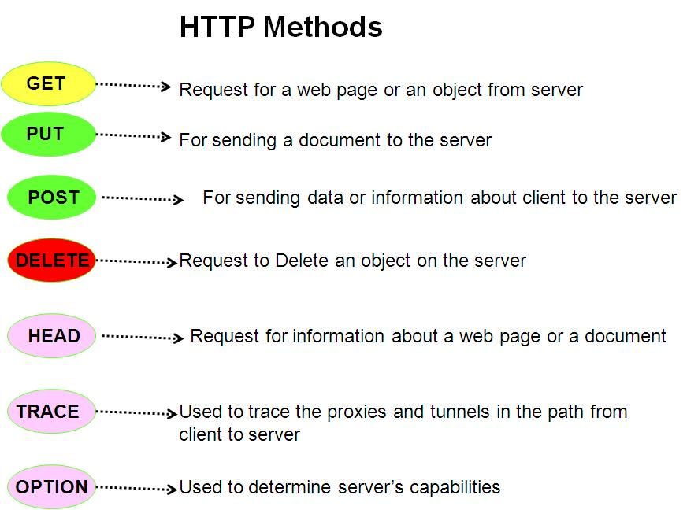

Slide 10
Get Vs. Post
http://www.diffen.com/difference/GET_(HTTP)_vs_POST_(HTTP)

Slide 11
Food for thought
What would happen if a Web client was poorly programmed and instead of sending a message beginning with “GET” it sent a message beginning with “QET?”

Slide 12
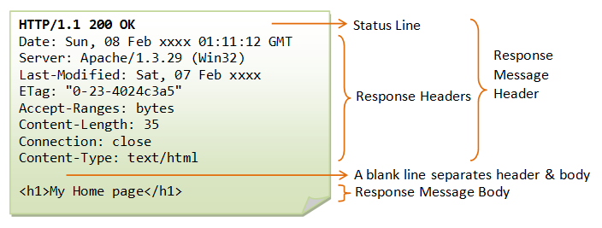
Http Header - response

Slide 13
Status code
1xx (Informational): Request received, server is continuing the process.
2xx (Success): The request was successfully received, understood, accepted and serviced.
3xx (Redirection): Further action must be taken in order to complete the request.
4xx (Client Error): The request contains bad syntax or cannot be understood.
5xx (Server Error): The server failed to fulfill an apparently valid request.
http://en.wikipedia.org/wiki/List_of_HTTP_status_codes

Slide 14
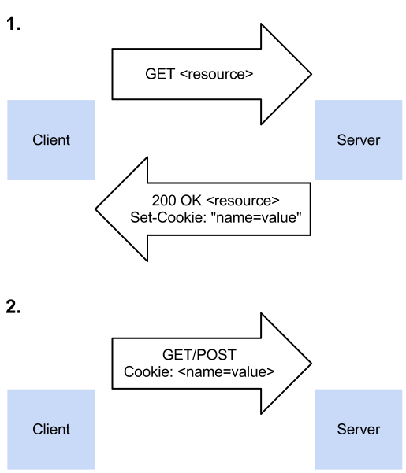
Http Cookie
What is a cookie?
https://www.youtube.com
/watch?v=I01XMRo2ESg
Why using cookies?
Http is stateless!

